Slide 1



CIPA Visit to ASPA
5 October 2016
Carin Burchell
Member,
CIPA International Liaison Committee
IN ASSOCIATION WITH

Slide 2
Update on UK and EU Registered Designs
Carin Burchell
BRANDED!
c.burchell@trade-mark.co.uk

Slide 3
Summary of Presentation
PMS International Group Plc (Respondent) v Magmatic Limited (Appellant) [2016] UKSC 12
What has this case taught us about the way to file EU and UK Registered Design Applications?
“Modernisation” of Designs Registration in the UK

Slide 4
“It is, of course, up to an applicant as to what features he includes in his design application.” – Lord Neuberger
The Registered Design may be valid (i.e. novel and having individual character); but
Not infringed
Very careful consideration is needed before deciding how to file Registered Design Applications
Guidance Notes:
  UK IPO: https://www.gov.uk/government/uploads/system/uploads/attachment_data/file /507951/DF2A_fillable.pdf
  EU IPO: https://euipo.europa.eu/ohimportal/en/what-can-be-a-registered-community-design

Slide 5
“…the question must ultimately depend on the proper interpretation of the registration in issue, and in particular of the images included in that registration.” Lord Neuberger
Scope of protection includes “any design which does not produce on the informed user a different overall impression”
“Proper interpretation” means that applicants (and their advisers) must carefully select how their design is represented on the Register
“…the selection of the means for representing a design is equivalent to the drafting of the claims in a patent: including features means claiming them.” – Dr. Martin Schlötelburg, coordinator of the EU IPO’s Designs Department

Slide 6
Which to choose?
1) Line drawings
PMS v Magmatic, discussing The Procter & Gamble Company v Reckitt Benckiser (UK) Limited, that line drawings are generally the most suitable form for designs which seek to protect only the physical shape of a product – i.e. “shape only” designs
Also noted as being less appropriate for showing colouring, ornamentation and decoration
“A line drawing is much more likely [than a CAD image] to be interpreted as not excluding ornamentation.” The Supreme Court went on to quote Dr Schlötelburg, who noted that “the broadest claims can be achieved by [line] drawings showing only the contours of the design.”

Slide 7
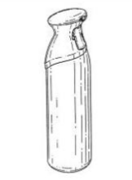
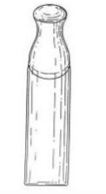
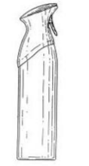
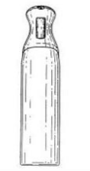

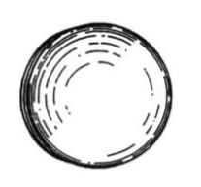
Line drawing filling from the Community registered design in dispute in P&G v Reckitt Benckiser [2007] EWCA Civ 936

Slide 8
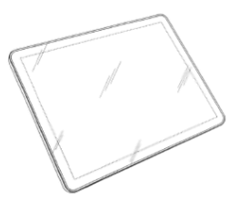
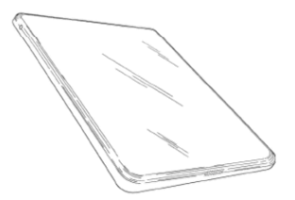
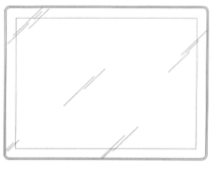




But sometimes even line drawings may be interpreted as specifically claiming a lack of decoration. In Samsung Electronics (UK) Limited v Apple, Inc. [2013] EWCA Civ 1430, the Court of Appeal confirmed that the absence of ornamentation may be a feature of a design filed as a line drawing

Slide 9
2) CAD Images
CAD images are more appropriate than line drawings where the applicant is seeking to protect surface decoration and/or ornamentation, because they can: “easily show subtle shadings and contours, as well as decoration, such as colours and ornamentation”.

Slide 10
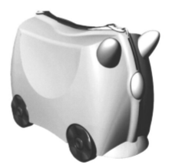
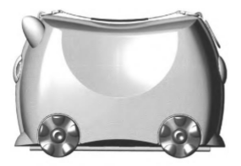
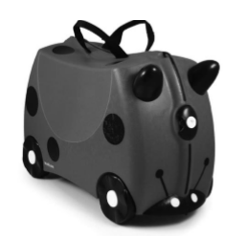


Slide 11
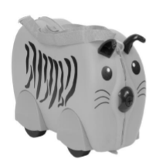

The Kiddee Case

Slide 12
40. As he explained in paras 41 and 47 of his judgment, Kitchin LJ disagreed with Arnold J when it came to the question of the decoration on the Kiddee Case. Kitchin LJ was of the view that the fact that the CRD image was “not adorned with any … imagery” reinforced the impression it gave of “a horned animal with a nose and a tail”. By contrast, he said, “the impression” which the shape in the first example of the Kiddee Case in para 4 above creates is “clearly influenced by the two tone colouring of the body and the spots on its flanks”, so that “it looks like a ladybird and the handles on its forehead look like antennae”. This, he said, effectively reinforced the conclusion that the Kiddee Case produced on the informed user a completely different overall impression from the horned animal embodied in the CRD design. The same conclusion, he said, applied to the second example of the Kiddee Case, as “[t]he stripes on its flanks and the whiskers on either side of its nose immediately convey to the informed user that this is a tiger with ears. It is plainly not a horned animal.”

Slide 13
41. In my view, the point which Kitchin LJ was making in this second criticism was that the absence of decoration on the CRD reinforced the horned animal impression made by the CRD.

Slide 14
3) Photographs
Widely acknowledged that photographs will tend to provide the narrowest scope of protection
“a photo specifies not only the shape, but the surface structure and the material… narrowing the scope of protection accordingly” – Dr Schlötelburg
Not recommended unless
  (i) only a narrow scope of protection or
  (ii) there is no alternative way to present the product which is sufficiently detailed to provide protection for the novel and individual parts of the product

Slide 15
4) The Gold Standard
All 3

Slide 16
Aims of UK IPO in connection with their Designs Modernisation
Online filing for designs
Criminal Sanctions for registered designs
Sign up to Hague Agreement
Reduce fees
Appointed person appeal process for Designs
IPEC small claims track for registered designs
Webmarking for designs
Review and update design rules

Slide 17
Apply to Register a Design online
‘BETA’ service launched on 30 September
Updated 12 times to introduce additional or improved features
Ability to file multiple designs
70% of designs applications filed digitally
Deposit account
Designers only registering the designs they think will be their best sellers
EU IPO – seen as better option for UK business due to convenience of on-line filing and the fees themselves
The UK IPO are reducing their designs fees from 1 October 2016

Slide 18
Application Fees
1 single online application £50
Multiple online designs £70 for up to 10 designs
£20 for every 10 online thereafter (i.e. 11-20)
Consider Hague
Renewal Fees
 | 5 – 10 years | 10 – 15 years | 15 – 20 years | 20 – 25 years
Old | £130 | £210 | £310 | £450
New | £70 | £90 | £110 | £140
Saving | £60 | £120 | £200 | £310

Slide 19
Illustrations should
Show the design as it appears to the eye, using photographs, line drawings, computer-aided design (CAD) or rendered CAD
Show the design against a plain background, with no details hidden by shadows or reflections
Show all relevant views of the design, eg front view - include up to 7 illustrations, one per page
Not contain measurements or other technical information
Not include anything that isn’t part of the design, eg another object or your hand
If you’re applying by post, your illustrations should be on plain A4 paper.

Slide 20
Add More Information
Mention on your application anything that might be unclear from your illustration alone, e.g. if:
  You only want to register the surface pattern of an object
  You don’t want to register the colour
  There’s something shown that is not relevant, eg a mannequin to display the clothing you are registering

Slide 21
Illustrating parts of a product
Only show the parts of your design that you want to protect

Slide 22
DO’S AND DON’TS
https://www.gov.uk/government/publications/application-to-register-one-or-more-designs

Slide 23
For more information please contact:
Chartered Institute of Patent Attorneys
95 Chancery Lane, London WC2A 1DT
Telephone: +44 (0) 207 405 9450
Email: info@cipa.org.uk
www.cipa.org.uk
IN ASSOCIATION WITH

